Slide 1
Stack & Queue
many applications use a list data structure that do not require the full range of operations provided for a general list
stack and queue are lists with restrictions on insertions and deletions

Slide 2
Stack
A linear list where
insertions and deletions are performed at the same end - called the top of the stack
i.e. a LIFO (last-in first-out) linear list
A stack can be represented using either an array or a linked list.

Slide 3
In linked list implementation, will only need one reference: first
push() is the function to add an element
pop() is the function to remove an element

Slide 4
java.util provides a class Stack
But the java documentation states:
A more complete and consistent set of LIFO stack operations is provided by the Deque interface and its implementations, which should be used in preference to this class.

Slide 5
Application of stacks
Balancing parentheses
E.g. (2+[5+7]+1) is balanced.
Is {x + [4+(1+y)}] balanced?
Evaluating arithmetic expressions -
Undo feature of a word processor
Issued commands are kept in a stack
Select “Undo”, the last command is undone, then the next-to-last etc
Handling method/function calls
Notes:
Evaluating arithmetic expressions: Use 2 stacks: one for operators and one for numbers. Keep stacking until the operator on top of stack is higher than operator just read.

Slide 6
Handling method/function calls
When high-level languages are compiled, functions/methods and main routine generate separate blocks of low-level code, each at different locations in memory

Slide 7
JVM Run-time stack
JVM (Java Virtual Machine) maintains a run-time stack when an application is running
For each method that is called, JVM saves information about it in the form of an activation frame

Slide 8
Activation frame has storage for:
Method arguments
Local variables
Return address of the instruction that called the method
Whenever a method is called, java pushes a new activation frame onto the run-time stack
www.linkedin.com/pulse/java-runtime-stack-mechanism-jrsm-youssef-najeh
Notes:
Also see https://www.geeksforgeeks.org/run-time-stack-mechanism-java/

Slide 9
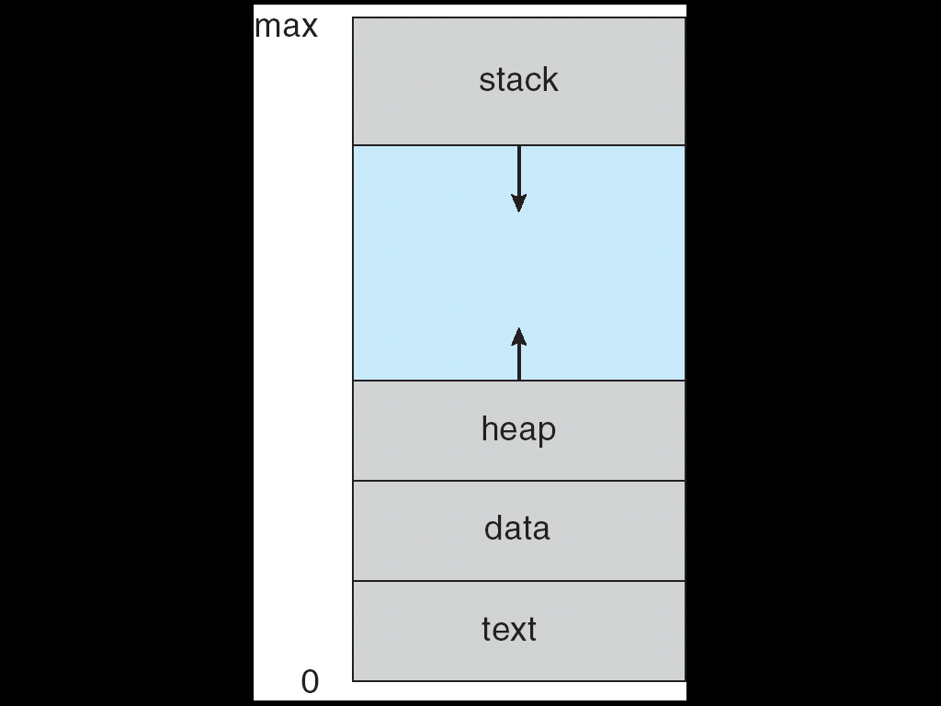
A program (process) in memory

Slide 10
In sample code: main calls haveFun method, which calls haveMoreFun. The return addresses are stored on the stack
main haveFun haveMoreFun
Call haveFun
Call haveMoreFun

Slide 11
Looking at run-time stack in IntelliJ
If code generates an exception e.g. divide by 0, you will see stack trace:
Having fun!
Exception in thread "main" java.lang.ArithmeticException: / by zero
Having more fun!
at package1.MoreFun.haveMoreFun(MoreFun.java:6)
at package1.Fun.haveFun(Fun.java:8)
at package1.Main.main(Main.java:9)
Notes:
If you catch the exception, you can output the stack trace:
e.g.
try { …
} catch (FileNotFoundException e) { System.out.println("File not found"); e.printStackTrace();
}

Slide 12
The call stack is visible while debugging:
https://stackoverflow.com/questions/18747590/intellij-idea-12-viewing-the-call-stack

Slide 13
Queue
A linear list where
items are added at the rear
items are removed from the front
i.e. a FIFO (first-in first-out) linear list
A queue can be represented using either an array or a linked list.
In linked list implementation, will need two references: first and last

Slide 14
Application of queues
often used in system software
e.g. in a multi-user system, a printer is shared,
requests to print a file are held in a queue.
Computers on a network are given access to files on file server on a first-come first-served basis i.e. a queue

Slide 15
queues are widely used in simulation to model the flow of objects through a system
e.g. simulate a check-out at a supermarket

